Slide 1
The Human Mobility Data Landscape
Applied Machine Learning Days - Lausanne, Switzerland
Notes:
Luca

Slide 2


Call Detail Records
(CDRs)

Slide 3
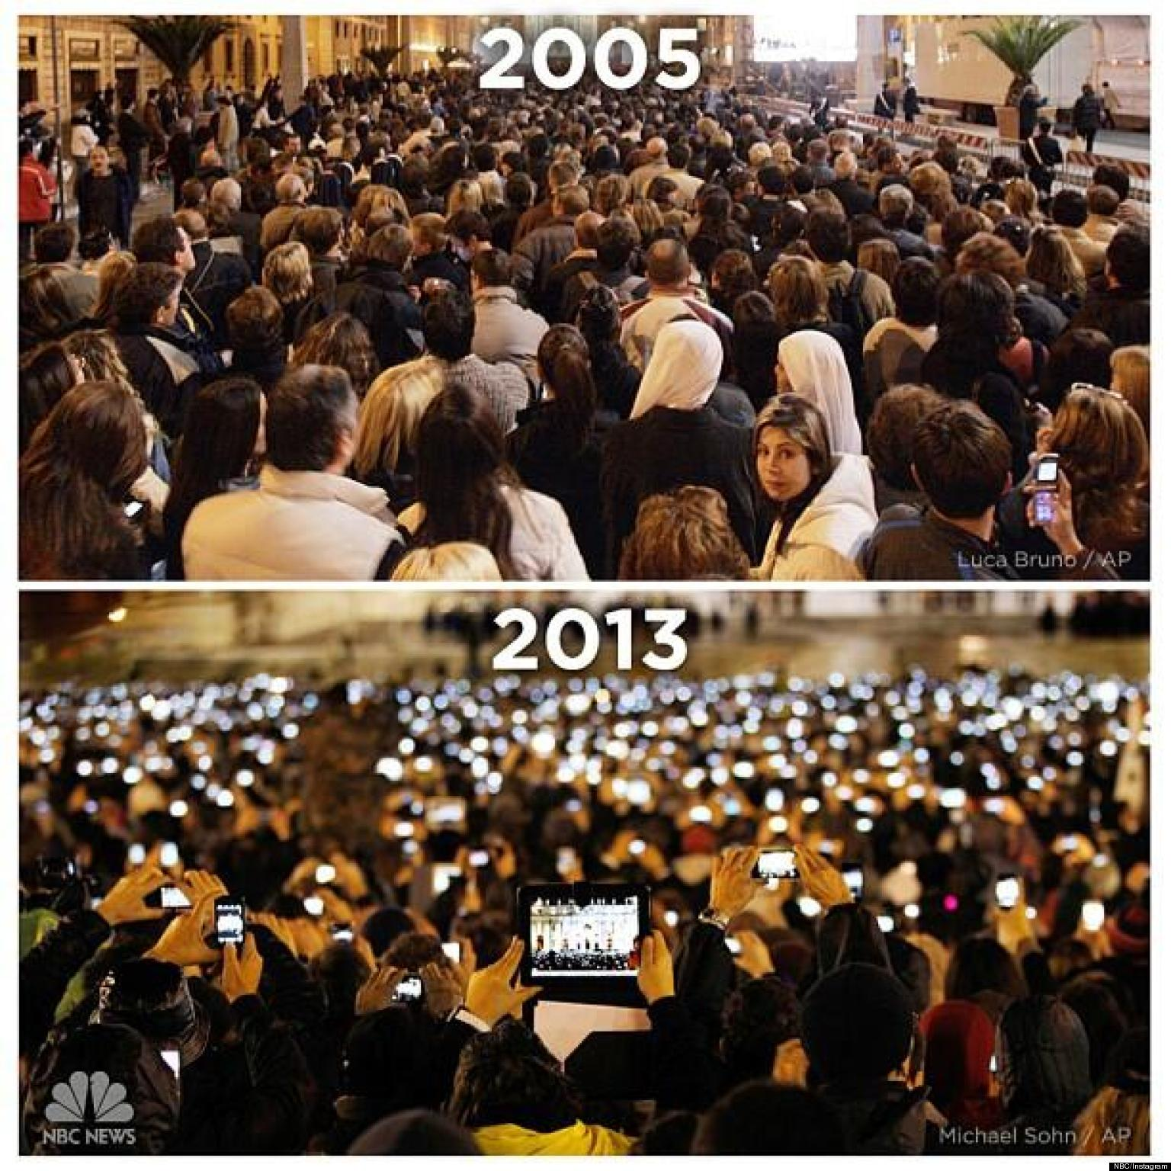
Notes:
This 2 photo represent the same event in different year. Which event is this?

Slide 4
Call Detail Records (CDRs)
Produced by a phone carrier to store details of calls passing through a device
They contain various attributes of the call:
timestamp | source | destination | tower | duration
10/04/2008 10:12:00 | A8563XY | C1123YT | 36256 | 10:32
10/04/2008 10:12:32 | B6766CS | H2223IU | 43860 | 03:07
... | ... | ... | ... | ...

Slide 5

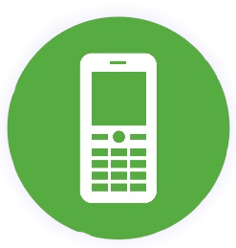
Call Detail Records (CDRs)
Location history
a
b
c
e
L=
b
c
a
e
d

Slide 6
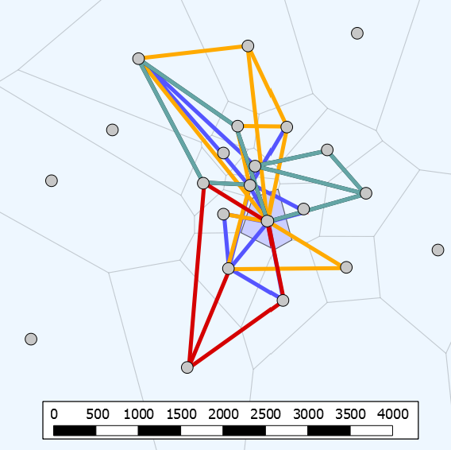
Inferring mobility trajectories from CDRs
Call Location/tower
Trajectory Sequence of locations
Home Most nighttime calls
Pappalardo et al., An analytical framework to nowcast well-being with mobile phone data, JDSA, 2016.

Slide 7

PROs and CONs of CDRs
PROs
mobile phones are ubiquitous
large (huge) sample size
rich and multidimensional (social, mobile, time, demographics)
CONs
not publicly available
position is partially detected (only when calls are made)
position is known at tower level only (resolution is variable from m to km)
ping-pong effect can create noise

Slide 8
Preprocessing on CDR data
Non-relevant locations are discarded (e.g., if n/N < 0.005)
Users calling from just one locations are discarded (they do not move!)
Users with too low or high calling activity are discarded (e.g. by imposing min and max average calls per day)

Slide 9


Available data extracted from CDRs
A multi-source dataset of urban life in the city of Milan and the Province of Trentino
Official Repository
Kaggle Repository
D4D Challenge - available upon request

Slide 10

References for CDRs
Understanding individual human mobility patterns (Gonzalez et al., Nature, 2008).
Human mobility prediction based on individual and collective geographical preferences.
(Calabrese et al., IEEE ITSC, 2010).
Friendship and mobility: user movement in location-based social networks.
(Cho et al., ACM SIGKDD, 2011).
A survey of results on mobile phone datasets analysis (Blondel et al., EPJ DS, 2015).

Slide 11
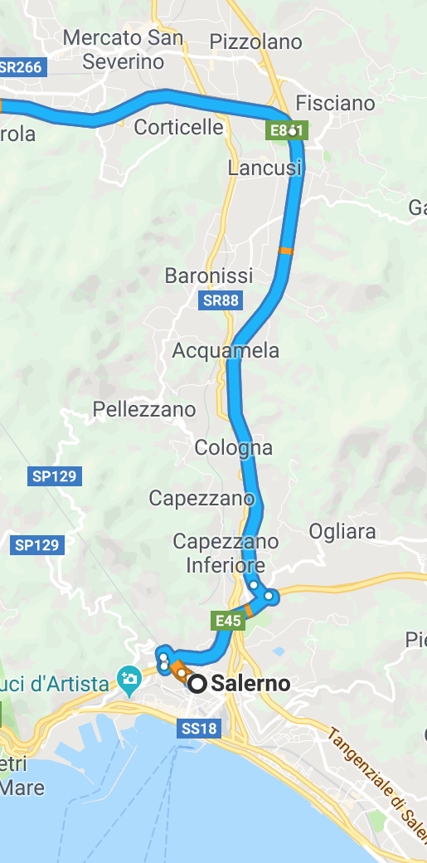
GPS
data

Slide 12
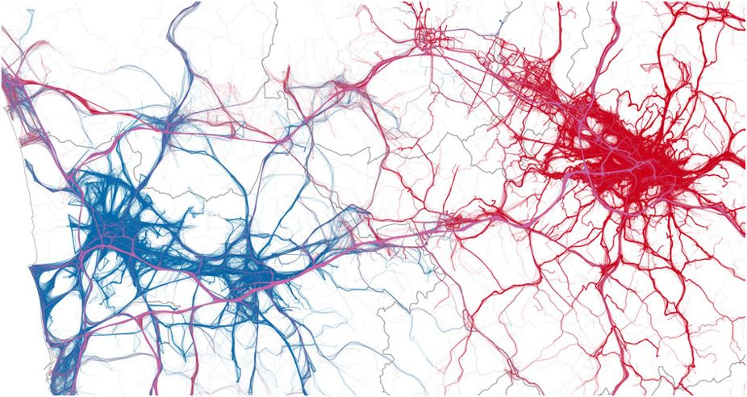
GPS data
Produced by GPS devices embedded in smartphones, private vehicles, boats, etc.
Pappalardo et al., Returners and Explorers dichotomy in Human Mobility, Nature Communications, 2015.

Slide 13
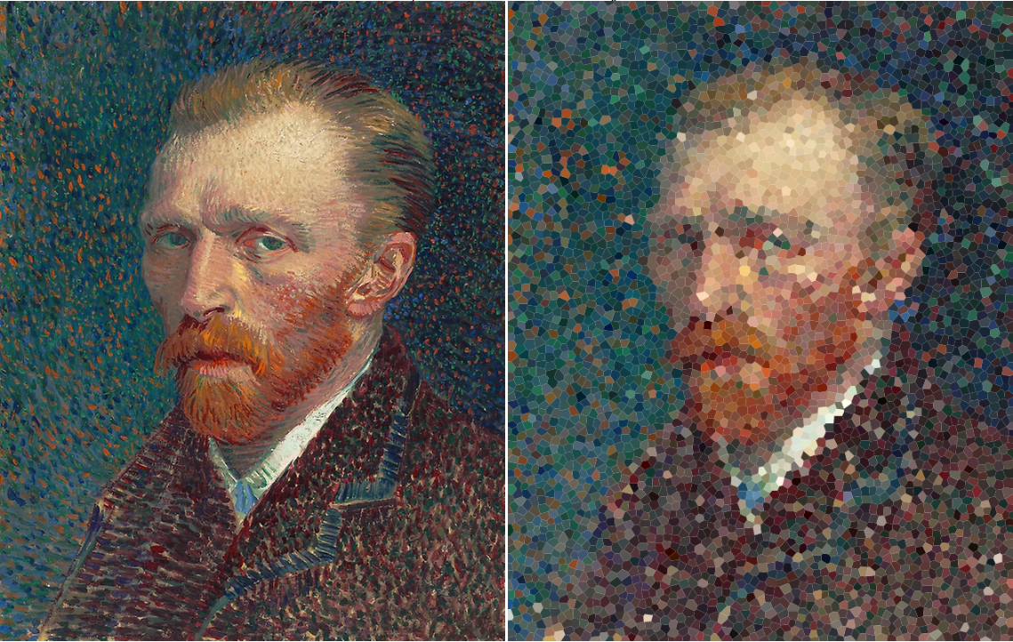
GPS data vs CDRs
CDRs
GPS

Slide 14
PROs and CONs of GPS data
PROs
trajectory at high spatial and temporal resolution
track the full trajectory (e.g., all cars movements)
CONs
no objective definition of location (preprocessing is needed)
errors when signal is noisy

Slide 15
Preprocessing on GPS data
Some common steps to apply on GPS data:
location detection group points into one meaningful location
trajectory segmentation split a trajectory in sub-trajectories

Slide 16
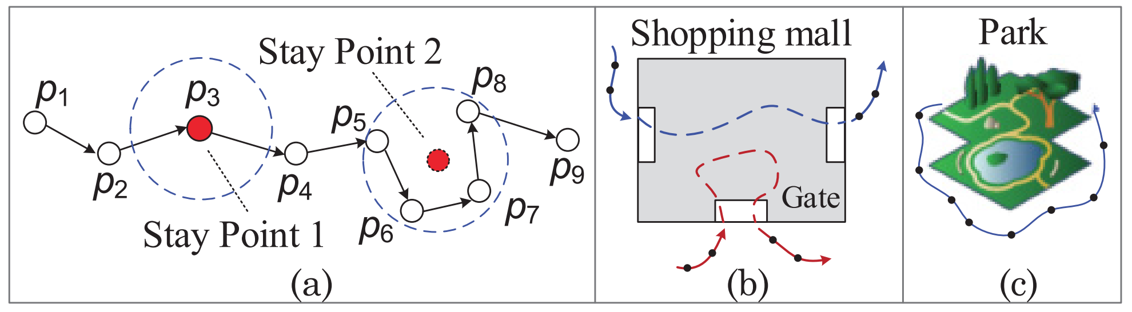
Location detection in GPS data
Locations (or stay points) denote places where people have stayed for a while
Zheng, Trajectory Data Mining: an overview, ACM TIST, 2015.

Slide 17
Stay Point detection algorithm
The points are scanned in temporal order, then if the following condition holds:
the points belong to the same stay point
Notes:
tutti i punti p_i che sono minore dei due delta appartengono tutti allo stesso stay point

Slide 18
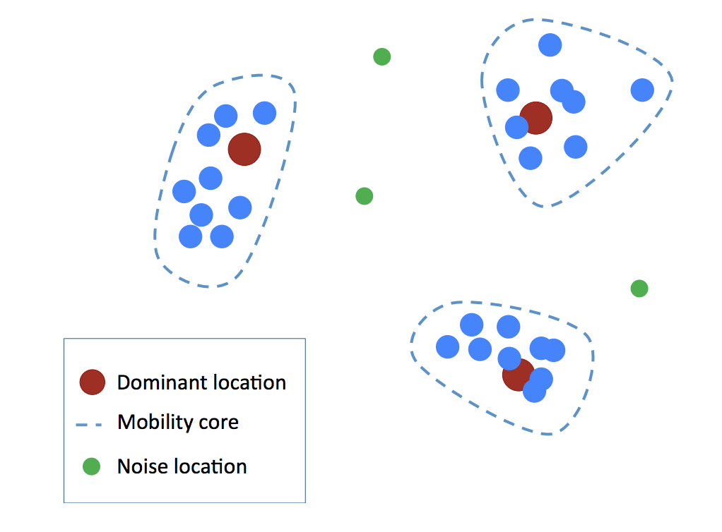
Semantic Location detection
Density clustering algorithm, like DBSCAN or OPTICS (time is not considered)
Notes:
on the previous point, we can add the detection of semantic locations on the stay points. (circles are stay points detected previously)

Slide 19
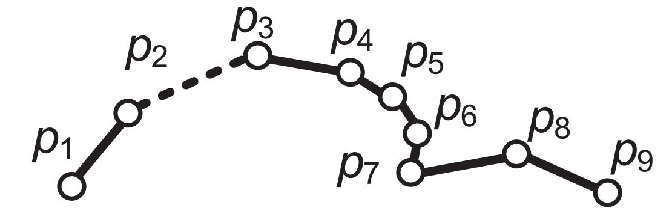
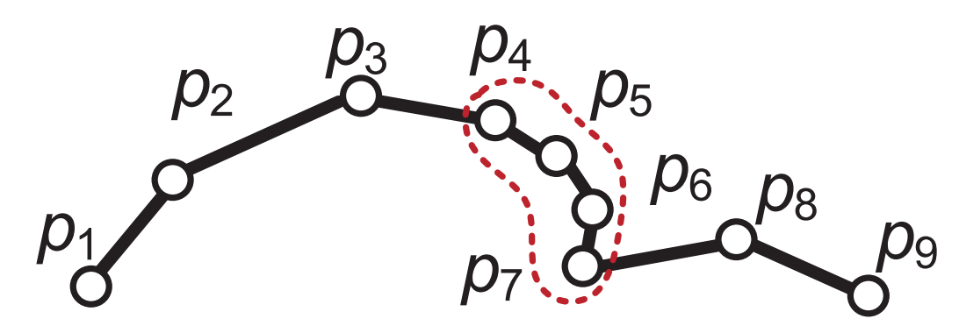
Trajectory segmentation
a trajectory is split into two or more sub-trajectories, with several techniques:
time-interval
stay-point
Zheng, Trajectory Data Mining: an overview, ACM TIST, 2015.

Slide 20



Publicly available GPSs datasets
Geolife GPS trajectory dataset
Official Repository
Taxi trajectory dataset (warning: not individual)

Slide 21
References for GPS data
Understanding the patterns of car travel
(Pappalardo et al., EPJ ST, 2013).
Learning travel recommendations from user-generated GPS traces (Zheng et al., ACM TIST, 2011).
Trajectory Data Mining: an Overview (Zheng, ACM TIST, 2015.)

Slide 22
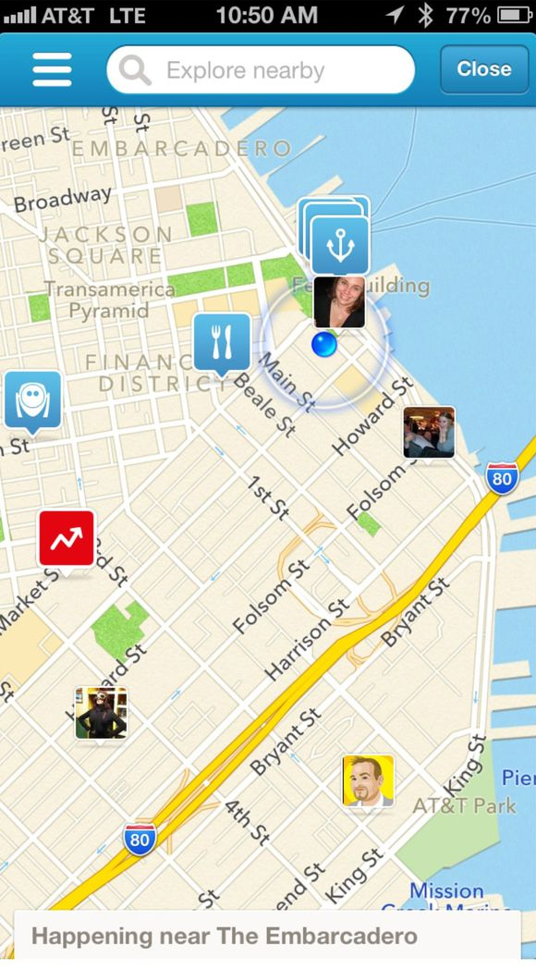
Location Based
Social Networks (LBSN)

Slide 23
Social Network + Location Data
Social Networks A social network is a social structure made up of individuals connected by one or more specific types of interdependency.
Location Data A location can be represented in absolute (latitude-longitude coordinates), relative (100 meters north of the Space Needle), and symbolic (home, office, or shopping mall) form.

Slide 24
Location-Based Social Network (LBSN)
A new social structure made up of individuals connected by the interdependency derived from their locations in the physical world as well as their location-tagged media content.
Location-Based Social Networks: Users
(Y. Zheng, Computing with Spatial Trajectories. Springer.)

Slide 25
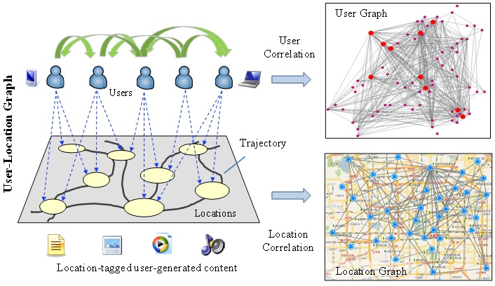
Location-Based Social Network (LBSN)

Slide 26
PROs and CONs of LBSNs
PROs
often publicly available
objective location and semantic information (e.g., restaurant, mall, etc.)
CONs
movement is partially detected (only when checkins are made)
data sparsity (more sparse than CDRs)
position is known at location level only
self-selection bias

Slide 27
References for LBSNs
Location-Based Social Networks: Users (Y. Zheng, Computing with Spatial Trajectories. Springer.)
Mobility and geo-social networks (Spinsanti et al., Mobility Data, Cambridge press, 2013).
A tale of many cities: Universal Patterns in Human Urban Mobility (Noulas et al., PLoS One, 2012).
Understanding Human Mobility from Twitter (R. Jurdak, PLoS One, 2015).

Slide 28




Public datasets
YFCC100M: geotagged photos from Flickr
Brightkite: checkins in different countries
Notes:
Google s2: https://s2geometry.io/
OpenStreetMap https://www.openstreetmap.org/
Google Places
Facebook business points

Slide 29


Public datasets
Foursquare: checkins in different countries
Notes:
Google s2: https://s2geometry.io/
OpenStreetMap https://www.openstreetmap.org/
Google Places
Facebook business points

